Slide 1
Schedular Program
Jacob Huerta, Ben Sprankle, Martin Aguilar
CompSci-2
04/19/2025

Slide 2
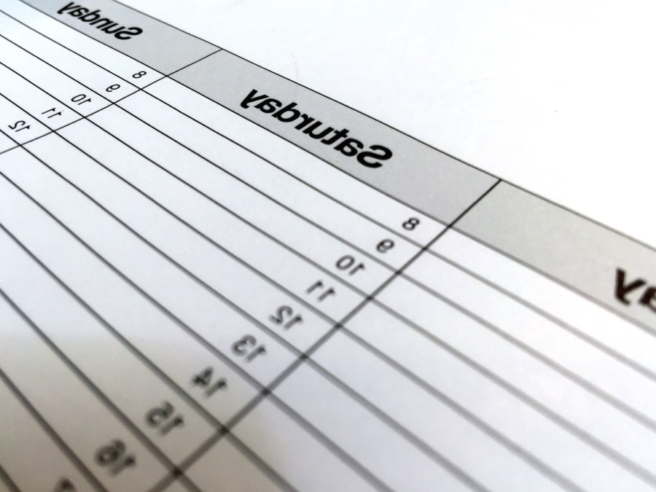
Hello! We created this Schedular program In order to assist others in simplifying their day-to-day needs in a proper organized fashion for their day!

Slide 3

Implementation
This Scheduler class was created to help users organize tasks based on priorities and time allocation. It allows the user to input tasks, assign priorities, and specify how much time each task requires. The program then reorders the tasks based on their priority and incorporates blocked times for specific days.

Slide 4
DEMo
Make eye contact with your audience to create a sense of intimacy and involvement
Weave relatable stories into your presentation using narratives that make your message memorable and impactful
Encourage questions and provide thoughtful responses to enhance audience participation
Use live polls or surveys to gather audience opinions, promoting engagement and making sure the audience feel involved

Slide 5
Future work/conclusion
ENHANCING YOUR PRESENTATION

